Slide 1
Hotel Ordinance
Presentation
Part of the Human Trafficking Resource Center

Slide 2







What is human trafficking
Sex trafficking is the use of force, fraud, or coercion to cause a commercial sex act. Force, fraud or coercion is not needed if it is a minor.
Labor Trafficking is the use of force, fraud, or coercion to compel a person for labor or services in involuntary servitude, peonage, debt bondage, or slavery
The difference between wage theft and labor trafficking is freedom of movement
FEAR
Protection
Home
Love
VIOLENCE
.
INTIMIDATION
Adventure
Opportunity
THREATS
to maintain and assert control over victims to ensure compliance and meet the demand
American dream
Employment
© City of Houston, Mayor’s Office, 2023. Used with permission.

Slide 3
What is human trafficking
80%
of the respondents reported that commercial sex occurred at a hotel or motel
69%
of the respondents reported that hotels or motels were used during travel
.
20%
of the respondents reported that a trafficker housed a victim at a hotel
Potential human trafficking victims encounter the hospitality industry daily—whether they’re forced to engage in commercial sex, seeking safe refuge after fleeing their trafficker, living temporarily on-site, or being trafficked by the hotel.
Source: On-Ramps, Intersections, and Exit Routes: A Roadmap for Systems and Industries to Prevent and Disrupt Human Trafficking: Hotels and Motels, pg. 16, https://polarisproject.org/wp-content/uploads/2018/08/A-Roadmap-for-Systems-and-Industries-to-Prevent-and-Disrupt-Human-Trafficking-Hotels-and-Motels.pdf (2018).​
​
© City of Houston, Mayor’s Office, 2023. Used with permission.

Slide 4
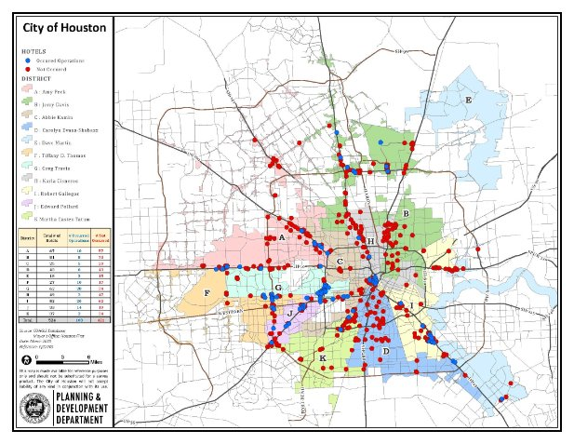
Hotel vs. HPD Ops – Capacity Issue
524 hotels in Houston as identified by red dots​
269 operations conducted by HPD at 116 locations over 4 years identified by blue dots​.
Ops conducted through HPD connections, calls from hotels or hot spots for prostitution​
​
Ops resulted in 674 Vice charges and HPD encountered 74 victims​
.
© City of Houston, Mayor’s Office, 2023. Used with permission.

Slide 5
Hotel vs. HPD Ops – Capacity Issue
District Breakdown shows how many operations conducted in hotels in your districts​
Demonstrates need for more eyes and ears to report trafficking if you look at the hotels that HPD may not have the capacity to reach​
If tips are accurately reported, may increase HPD efficiency​
​
District​ | Total # of Hotels/Motels/​ Extended Stay​ | # Operations Occurred​ | # Not Occurred​
A-Peck​ | 67​ | 10​ | 57​
B-Davis​ | 81​ | 8​ | 73​
C-Kamin​ | 25​ | 5​ | 20​
D-Evans-Shabazz​ | 43​ | 0​ | 43​
E-Martin​ | 18​ | 3​ | 15​
F-Thomas​ | 27​ | 10​ | 17​
G-Travis​ | 62​ | 28​ | 34​
H-Cisneros​ | 49​ | 2​ | 47​
I-Gallegos​ | 82​ | 20​ | 62​
J-Pollard​ | 33​ | 14​ | 19​
K-Castex-Tatum​ | 37​ | 3​ | 34​
.
© City of Houston, Mayor’s Office, 2023. Used with permission.

Slide 6
Local Ad Volume Data – Other Texas Cities​
Range: May 1, 2019 – February 13, 2020​
C@R is tracking commercial sex ads across 4 online sites in Texas
​
Houston has had 277,463 total ads over an 8 month period; 202,352 of the ads are unique​
These ads for illegal commercial sex are often posted by traffickers​
They offer indoor prostitution services as opposed to outdoor/street level prostitution​
Indoor prostitution frequently occurs at or in hotels or motels​
We are second to Dallas in number of ads
.
© City of Houston, Mayor’s Office, 2023. Used with permission.

Slide 7
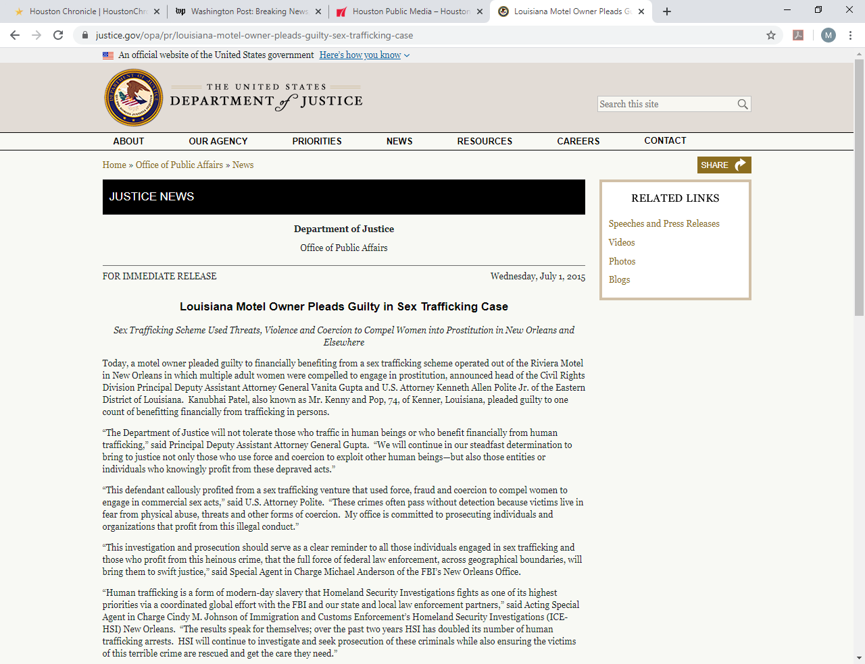
Case Study - HSI vs. Patel – New Orleans ​
HSI prosecuted case under TVPA –defendant plead guilty to knowingly benefitting from “participating in a venture that engaged in trafficking crimes.”
Defendant motelier charged traffickers higher rates and would open the back gate to allow customers entry​.
Defendant knew trafficker physically assaulted the victims, including a brutal beating of one with a large piece of wood while she screamed​.
The defendant also saw the damage to the motel room including a broken toilet, a damaged sink and blood on the walls​.
The defendant agreed not to call the police after being paid.
​
.
© City of Houston, Mayor’s Office, 2023. Used with permission.

Slide 8
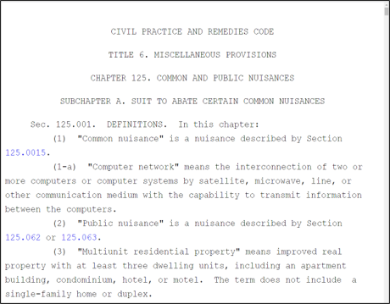
Case Study - Plainfield Inn - Houston​​
In a Chapter 125 nuisance and abatement suit, the State cited that from May 2014 through April 2016 there were over 400 calls for service to HPD at the Plainfield Inn, located off of the Bissonnet “track” which is known for street-level prostitution​.
Calls for prostitution arrests, drug offenses, weapons offenses, armed robberies, and theft on premises​.
A private civil suit was filed in 2017 by a victim’s mother after her minor daughter was found dead and was sex trafficked out of the Plainfield Inn​.
The plaintiffs alleged traffickers used the Plainfield Inn as their base of operations and defendants tolerated these activities to acquire a steady stream of income.​
Petitions stated that had the hotel employees been trained, the minor victim may have been rescued​.
​
.
© City of Houston, Mayor’s Office, 2023. Used with permission.

Slide 9
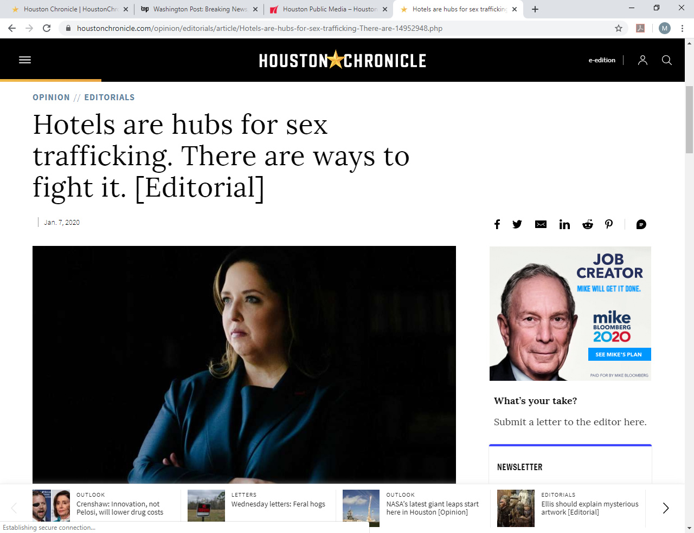
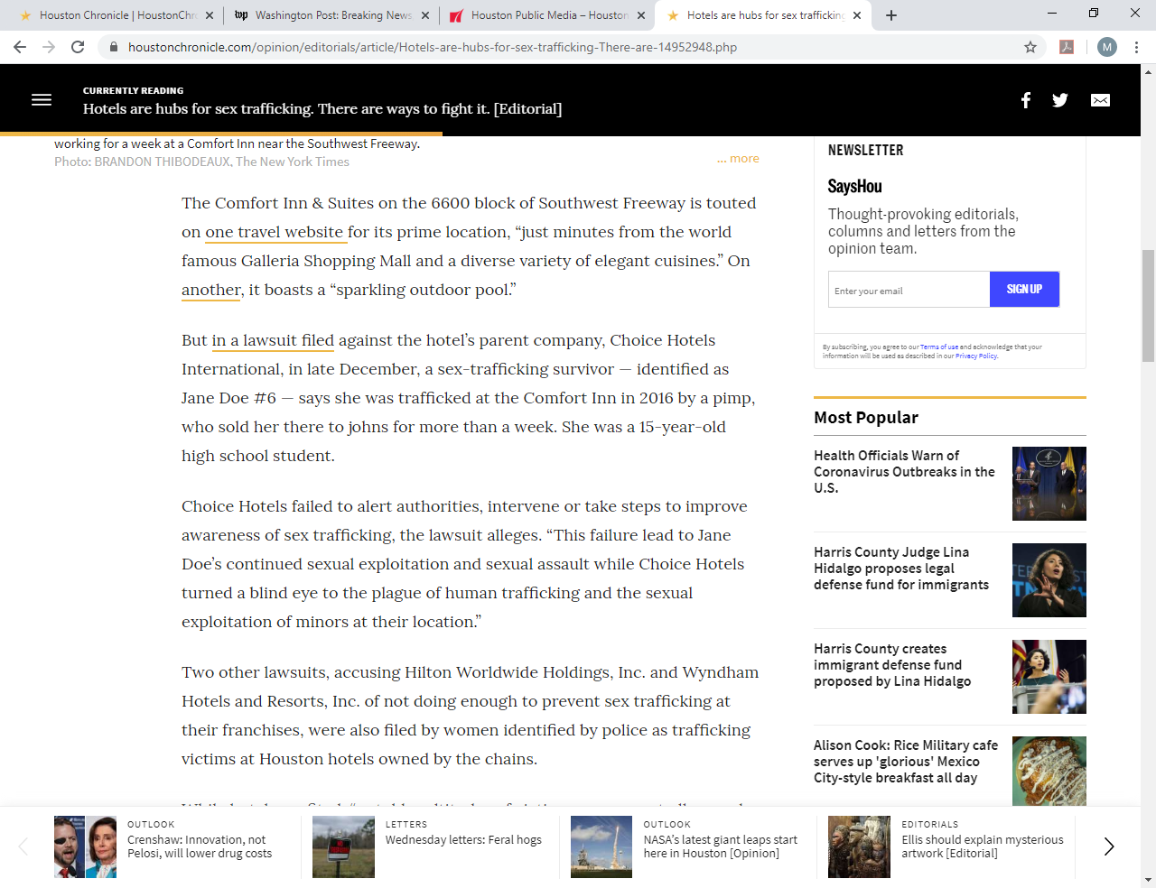
Case Study - Local Editorial and WSJ Article​
Chronicle Op-Ed reports several local chain hotels are subjects of litigation because trafficking occurred on-site and they did not report to law enforcement, promote staff awareness, or take substantive proactive steps to prevent it​.
“[…] a 15-year-old high school student identified as Jane Doe #6 says she was trafficked at the Comfort Inn and sold to buyers for more than a week​.
Wall Street Journal reported that over 40 lawsuits have been filed nationwide against hotel chains on 3/5/2020​.
This ordinance will empower employees and protect victims from exploitation through increased reporting​
We cannot wait for litigation to change hotels’ behavior, the risks are too great.
​
.
© City of Houston, Mayor’s Office, 2023. Used with permission.

Slide 10


Purpose of proposed ordinance
Adopting the hotel ordinance is a proactive approach and is consistent with the city’s comprehensive muni-response to human trafficking; increasing victim identification
Survivor study, Polaris data, HPD capacity vs. number of hotels, number of online sex ads in Houston, the case studies, Chronicle editorial and WSJ article all demonstrate the need​
Hotel employees have a vantage point to identify potential human trafficking victims​
Best way to leverage ARA to assist HPD in additional ways to increase tips​
​
.
Sex Trafficking Vulnerabilities of Hotels​
Escort Services​
Online Solicitation​
Outdoor Solicitation​
Labor Trafficking Vulnerabilities of Hotels​
Travelling Sales Crews​
Hospitality​
Commercial Cleaning Services​
© City of Houston, Mayor’s Office, 2023. Used with permission.

Slide 11

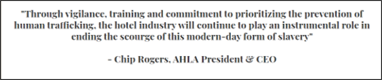
Industry trends
AHLA has model legislation they are proposing​.
Indication of industry recognizing the increased risk landscape for hotels/motels​.
Proposed ordinance encompasses many of AHLA’s recommended provisions​.
Does more to hold hoteliers accountable by instituting a monetary fine and tracking federal law in keeping the “should have known” requirement​
.
© City of Houston, Mayor’s Office, 2023. Used with permission.

Slide 12
Proposed hotel ordinance language training
Hotels must provide human trafficking training; certification of training required​
Hotel operators must provide training to each employee on how to identify human trafficking activities and victims, and how to safely report.
Training has a 20 minute minimum, train new hires within 30 days​.
The training must include:​
    A general overview on human trafficking, definitions under federal law, information on how to identify individuals at risk of human trafficking, the difference between sex and labor trafficking within the hotel industry, the contact information on how to report to the National Human Trafficking Hotline and local law enforcement​.
Free online training available in English, Spanish and 15 other languages​.
Free in-person training available in English and Spanish​.
​
​
.
© City of Houston, Mayor’s Office, 2023. Used with permission.

Slide 13
Proposed hotel ordinance language training certification & records
Hotels must provide human trafficking training; certification of training required​
A hotel operator must certify to the director annually that all employees have completed the required human trafficking training starting 3/31/2021.
A hotel operator must keep sufficient records to verify that all employees have in fact completed the training​.
Records must be produced within 72 hours of a request by ARA/HPD​.
ARA will collect certifications and enforce the ordinance by issuing citations for violations​.
HPD will also be able to issue citations if needed​
​
.
© City of Houston, Mayor’s Office, 2023. Used with permission.

Slide 14
Proposed hotel ordinance language sign posting
Display of Hotline Information and No Retaliation​
The following information must be displayed for employees in English and Spanish and in 10% of languages spoken by employees; city mandated sign will state:​
    Employees of the hotel receive annual human trafficking training​.
    Common indicators for both sex and labor trafficking specific to hotels​.
    Call the HPD Human Trafficking Unit[insert number], the National Human Trafficking Hotline at 1.888.373.7888 and if someone is in imminent danger, call 911, anonymous tips to police department are possible​.
    The National Human Trafficking Hotline is toll-free and available 24/7, can assist callers in over 200 languages, reports can be made anonymously also.​
    The ordinance does include a no retaliation clause to protect reporting employees​.
​
​
.
© City of Houston, Mayor’s Office, 2023. Used with permission.

Slide 15
Proposed hotel ordinance language penalties
Penalty
(insert specifics below; examples are for illustrative purposes only)
Each violation is punishable by a fine of $100 for first offense, $500 for future offenses.
Each day a violation continues constitutes a separate offense​.
4 possible violations: don’t train and/or certify, failure to turn records over in 72 hours, no sign posting and no employee retaliation​.
There is a 30 day period to cure violations​.
Scenario – Extreme
​ (insert specifics below; examples are for illustrative purposes only)
A hotel is in violation for 30 days after the 30 day cure period for each of the 4 offenses​.
1 day x 1st fine ($100) x 4 violations = $400 + 29 days x 2nd fine ($500) x 4 violations=$58,000 for a total of $58,400 in fines in just one month if a hotel fails to cure and ARA/HPD cites all daily.
.
© City of Houston, Mayor’s Office, 2023. Used with permission.

Slide 16
Proposed hotel ordinance language cost to city and conclusion
(insert specifics below; examples are for illustrative purposes only)​
Costs below are built into existing approved budgets​.
$27,000 for one time ARA/HITS development​.
ARA will allocate enforcement staff with a base annual salary of $51,000​.
A portion of the salary will go toward enforcing this ordinance​.
25% of time = $12,750​.
One time sign translation cost of $861 for 6 languages​.
Estimated total cost = $40,611 year 1, ongoing annual cost of $12,750.
ROI, for $40,000 the city will have 80,000 additional eyes and ears empowered to report​.
Only the 2nd city in U.S. to require trafficking training after Baltimore, they are implementing their 2015 ordinance now.
.
© City of Houston, Mayor’s Office, 2023. Used with permission.

